Slide 1
Workshop 4 – Spatial Analytics
Advanced Analytics and Applications [AAA]
Information Systems for Sustainable Society (is3) | WiSo Faculty | Univ.-Prof. Dr. Wolfgang Ketter | 5/1/22

Slide 2
I
Multiple Choice Questions
II
Programming

Slide 3
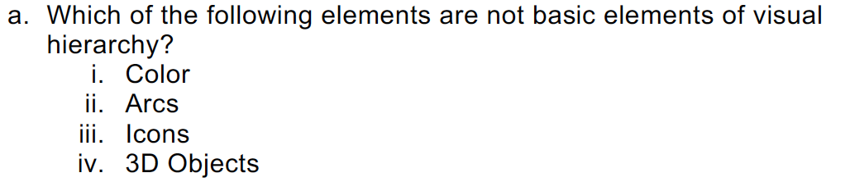
AAA Workshop
Question 1.1: Soft vs. Hard Clustering

Slide 4
AAA Workshop
Question 1.1: Soft vs. Hard Clustering
Solution: Technically, all of these element can be used to represent visual hierarchy. Color and Icons as discussed in the lecture. Arcs for Origin Destination pattern (thickness of arc), and 3D objects for buildings, AR applications (e.g., Pokemon Go)

Slide 5
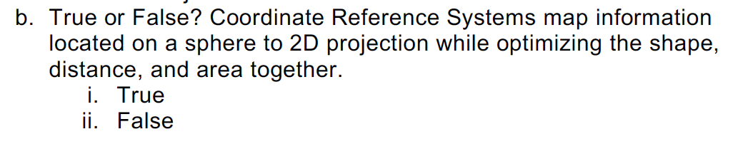
AAA Workshop
Question 1.1: Soft vs. Hard Clustering

Slide 6
AAA Workshop
Question 1.1: Soft vs. Hard Clustering
There exists no CRS that can optimize all three dimension all together. Select the CRS that is catered for your needs

Slide 7
I
Multiple Choice Questions
II
Programming

Slide 8
Contact
For general questions and enquiries on research, teaching, job openings and new projects refer to our website at www.is3.uni-koeln.de
For specific enquiries regarding this course contact us by sending an email to the IS3 teaching address at is3-teaching@wiso.uni-koeln.de

